Slide 1
SIR and SEIR Model Simulation for COVID-19
Qinglu Sun, Mengchen Gong, Tianli Wu

Slide 2
Motivation
COVID-19
highly contagious
spreads quickly
has a long incubation period
droplet infection
Policy influence
Difference in models
What should we be aware of

Slide 3
Outline
Datasets
Influence of community type
SIR&SEIR model using mathematical equations
SIR&SEIR models using fixed number of nodes
SIR&SEIR models using real network data
Our simulation result compares to real world data

Slide 4
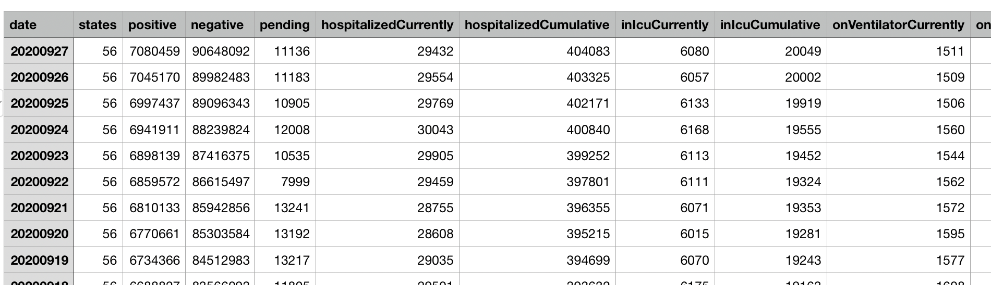
Datasets
https://www.kaggle.com/sudalairajkumar/covid19-in-usa
https://www.kaggle.com/kimjihoo/coronavirusdataset
Facebook100

Slide 5
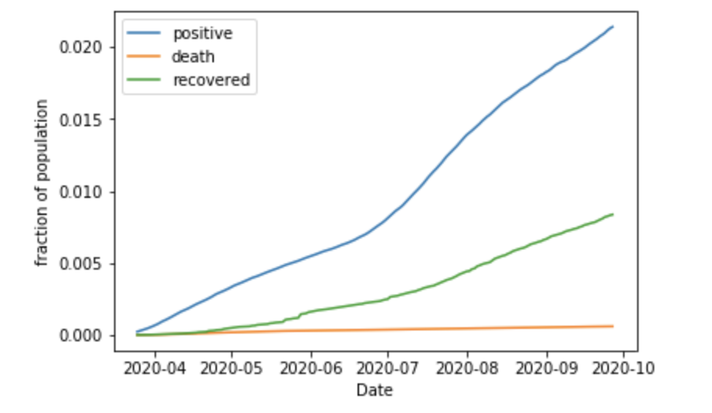
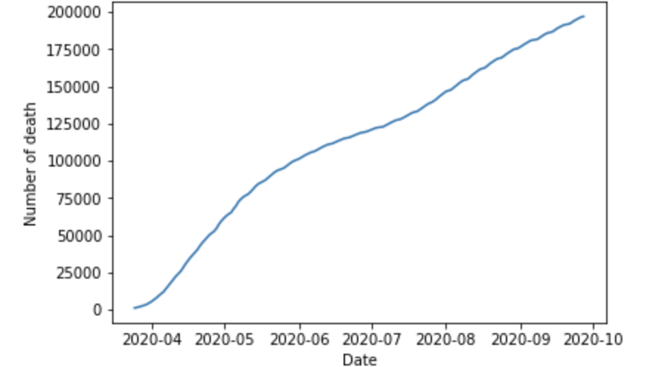

Slide 6
Epidemic simulation for different communities
Ordinary communities, namely residential areas.
Large crowded communities, such as grocery stores.
Isolated communities, such as hospitals.
Notes:
only acquaintances are allowed to visit or walk around in the community, so the chance of infection is small.
Types of activities for the general community:
1) Individuals walk randomly;
2) Gathering between friends and family.
There is a lot of people in this area, and people's walking trajectory is not fixed, but there will be crowds of people in some shelf areas. There are more people (r) you meet every day, and the infection distance will be greater
Unlike residential areas, people here have a clear purpose: buy what they need, check out and leave. So in
The setting of behavior involves finding the target and moving to the target.
Each "patient" has its own small room, among which there are not only patients infected with the virus, but also some other patients, such as appendicitis, influenza, etc., these people are included in the susceptible people in the procedure.

Slide 7
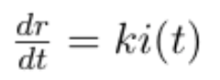
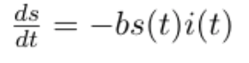
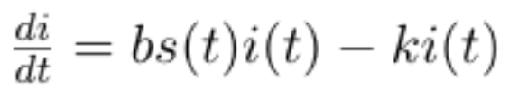
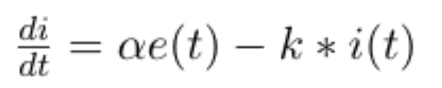
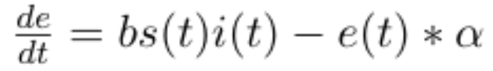
Mathematical SIR & SEIR
Assumption
We are ignoring births and immigrations
Fixed number of contact
Fixed fraction of group is removed each time step
The susceptible equation
The removed equation
The Infected equation
The exposed equation

Slide 8
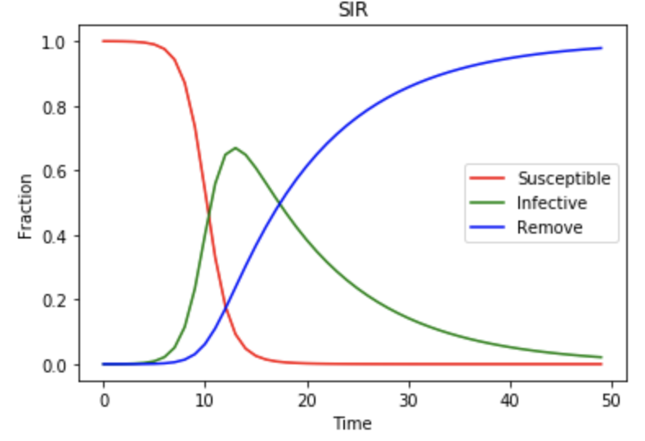
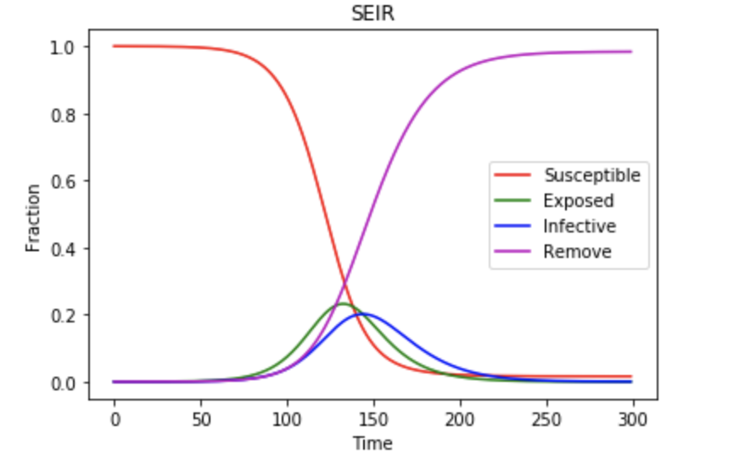
Mathematical SIR & SEIR

Slide 9
751
SIR Model Assumption
Recovered people will not get reinfected again
An Infected patient will continuously spread covid-19 until the patient recovers
Patients will recover at night, so the patients can still spread Covid-19 on that day
Patients will stay at home when they need to be isolated

Slide 10
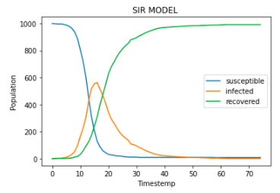
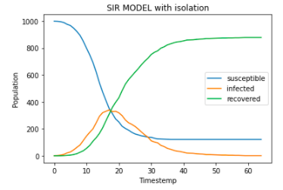
SIR models using fixed number of nodes

Slide 11
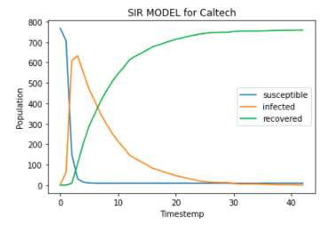
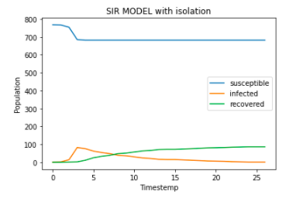
SIR models using real network data

Slide 12
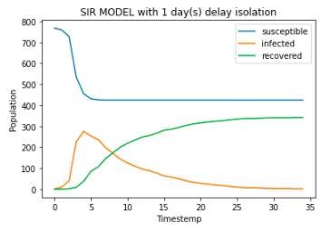
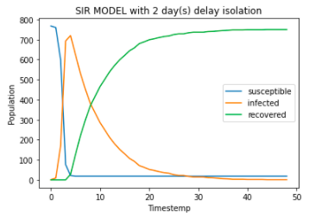
SIR models using real network data

Slide 13
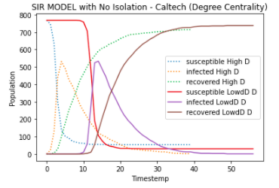
SIR models with centrality

Slide 14
SEIR Model Assumptions
E-I Duration (incubation period): 6 days
Isolation: grid graph (max 4 contact people) with same prob(S-E; E-I)
50% at stage E with default 2 day delay
100% at state I without delay
After Isolation, if still S, put back into original graph G
Recovered people will not get re-infected

Slide 15
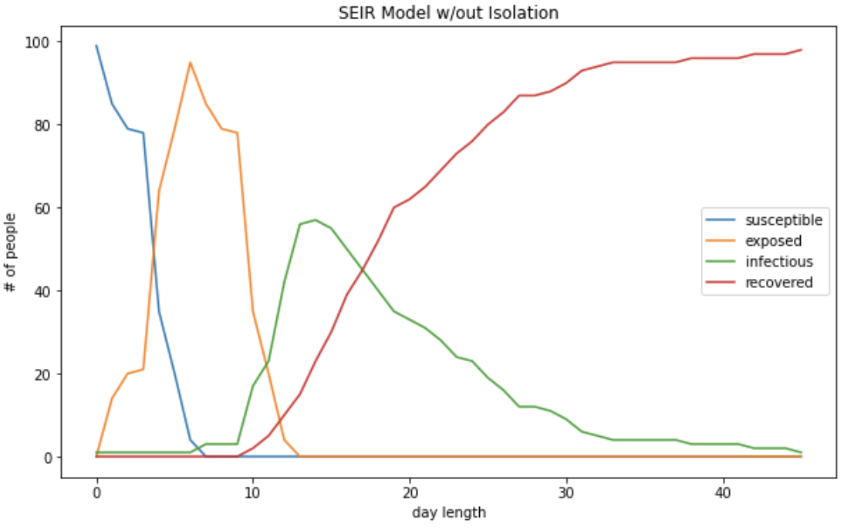
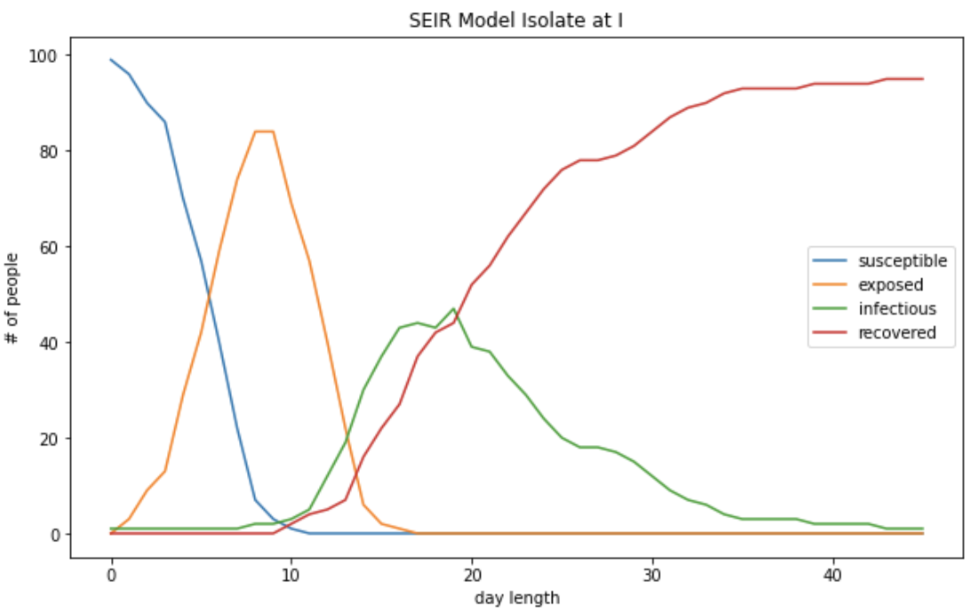
SEIR models using fixed number of nodes

Slide 16
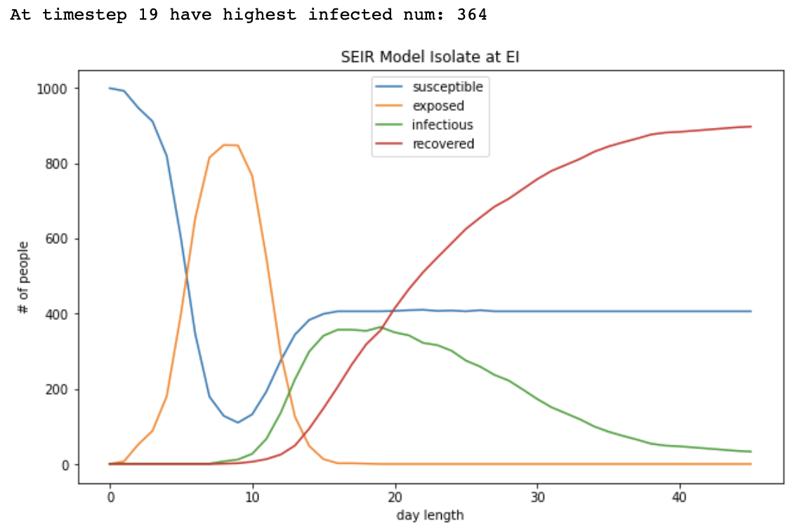
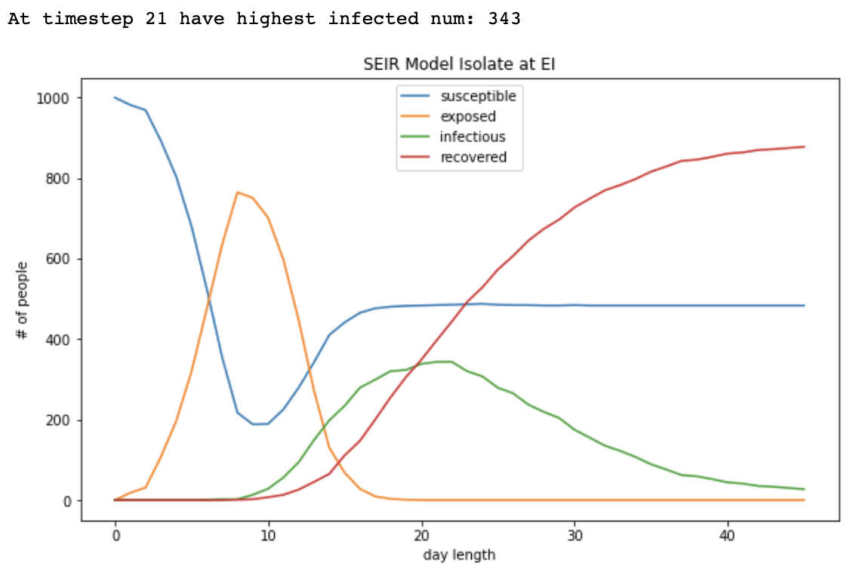
SEIR models using fixed number of nodes
6 days Isolation
14 days Isolation

Slide 17
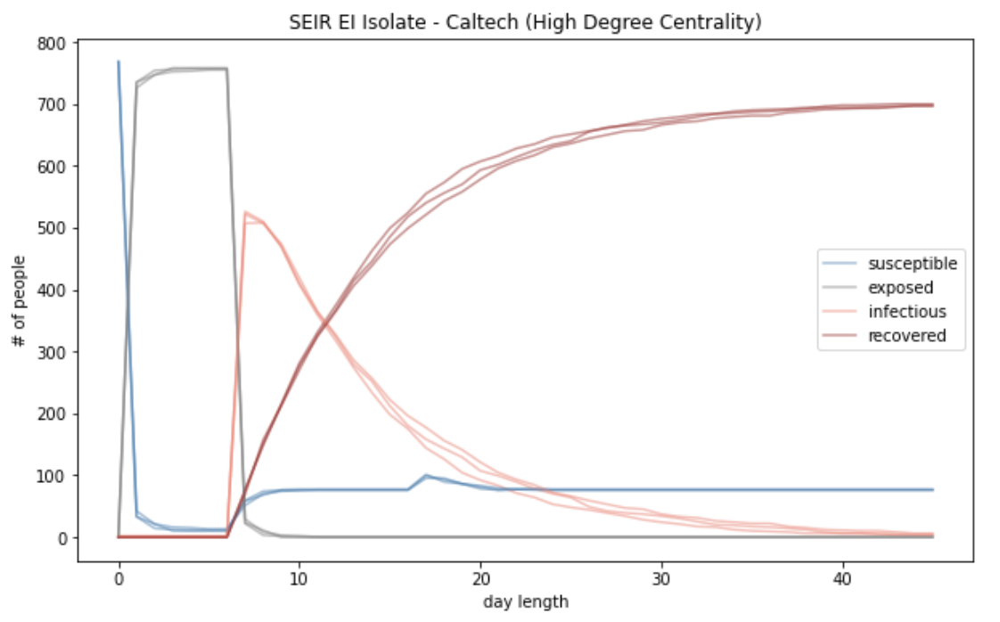
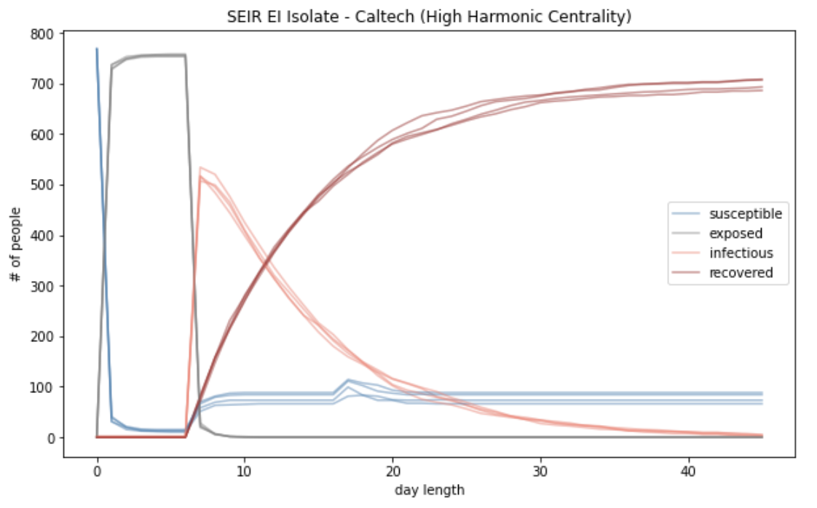
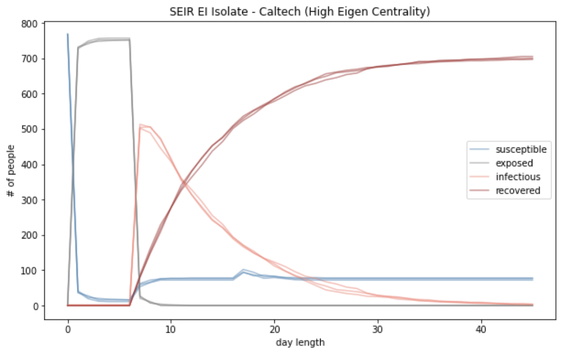
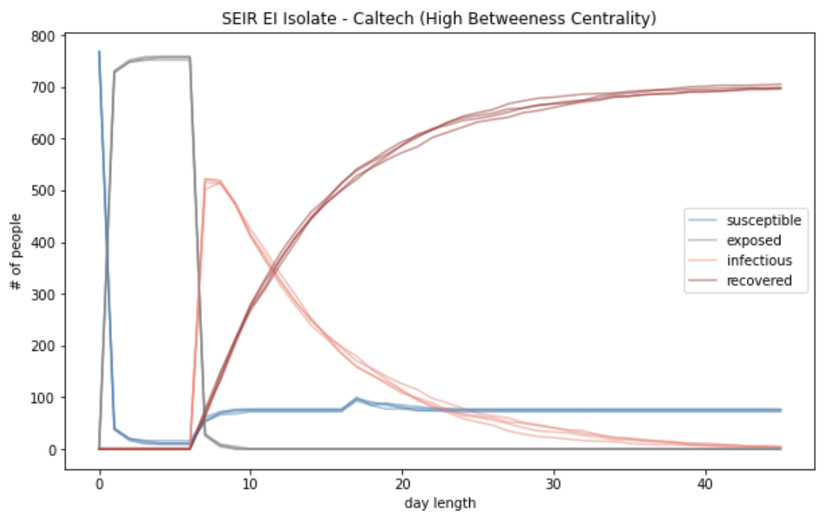
SEIR models using real network data
High Centrality

Slide 18
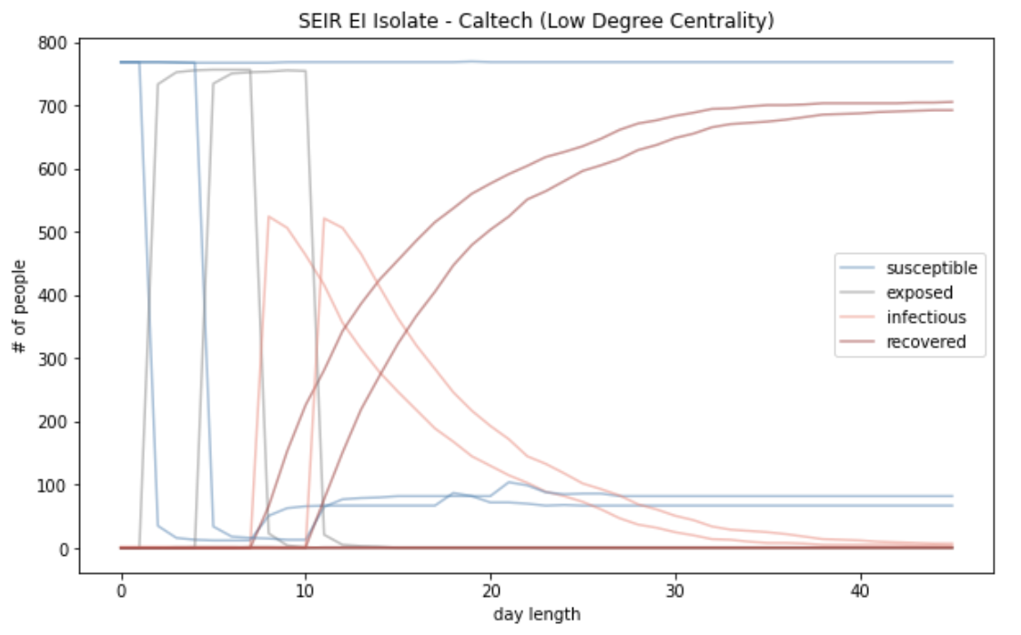
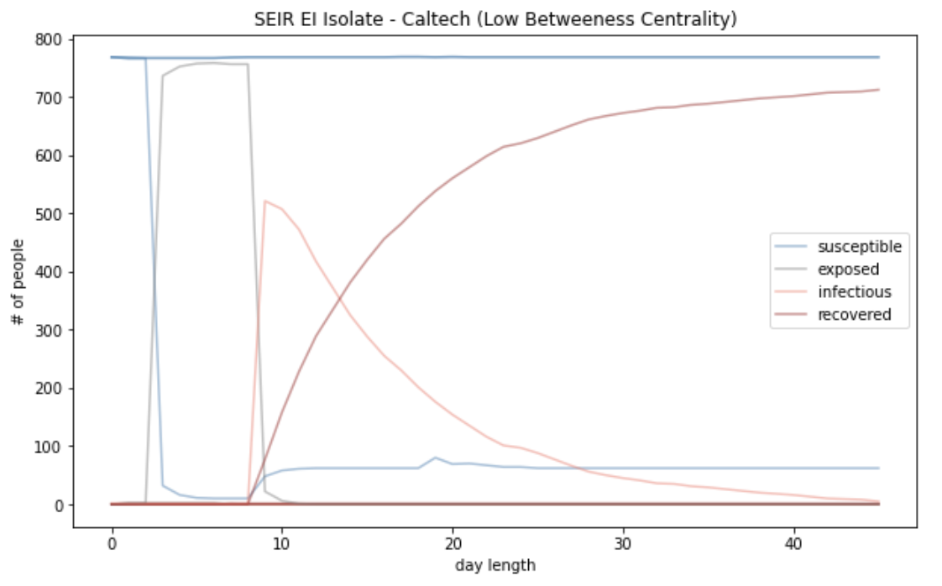
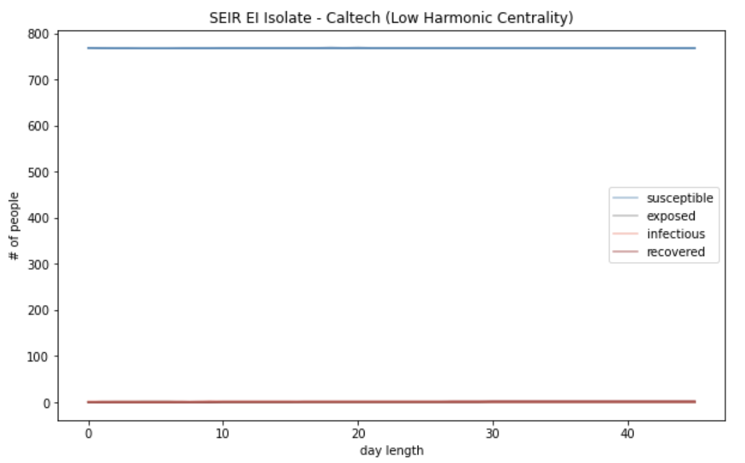
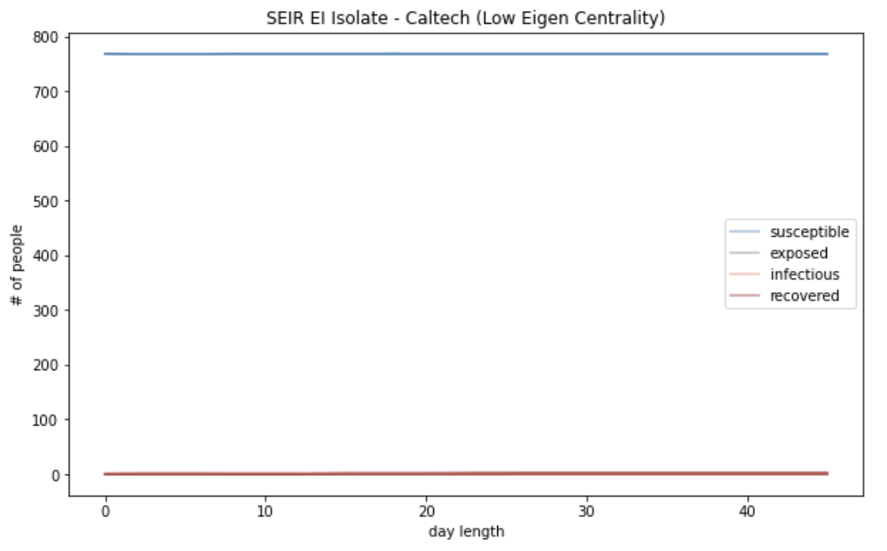
SEIR models using real network data
Low Centrality

Slide 19
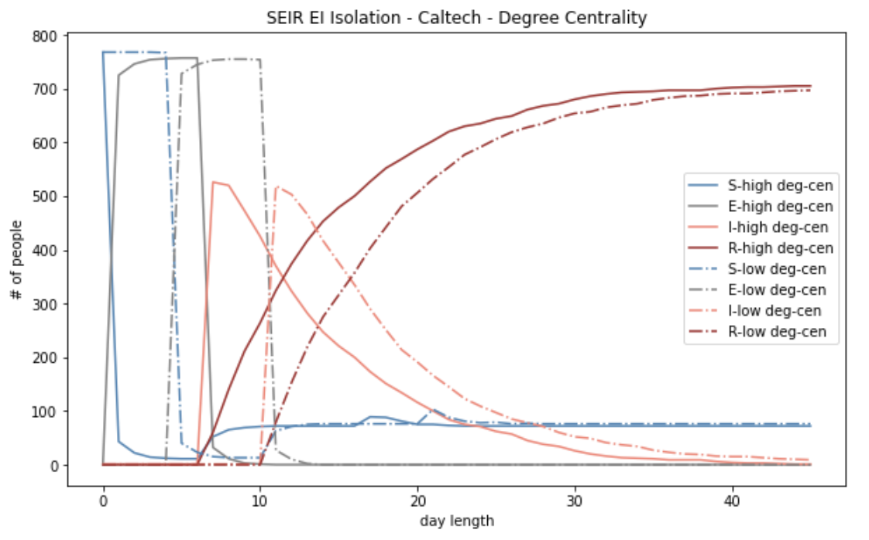
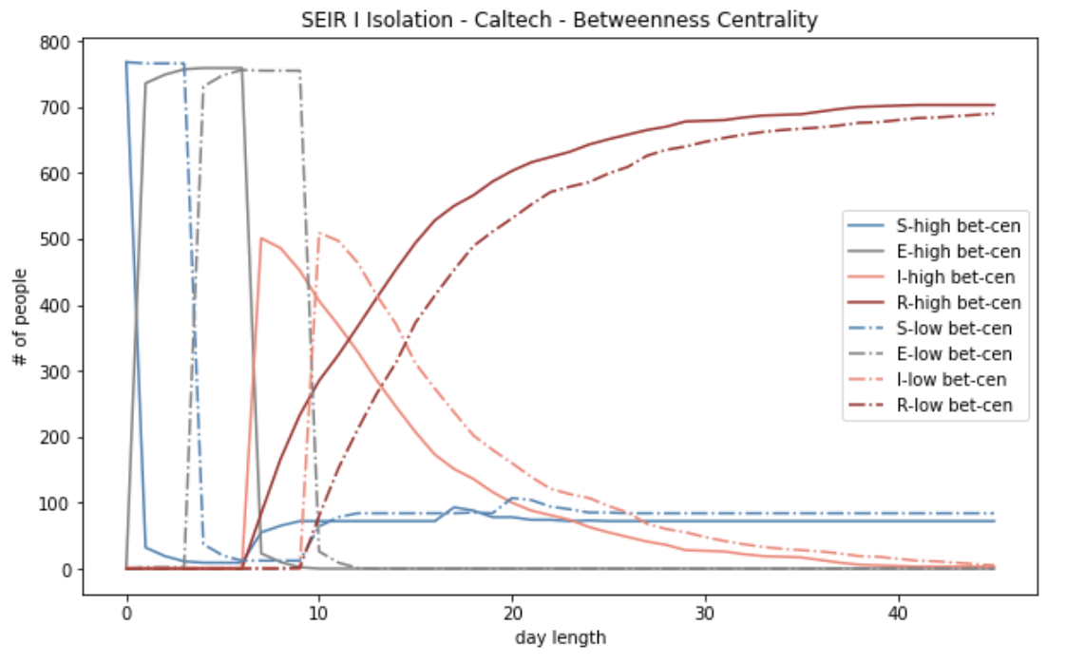
Centrality Analysis
High vs Low Degree Centrality
High vs Low Betweenness Centrality

Slide 20
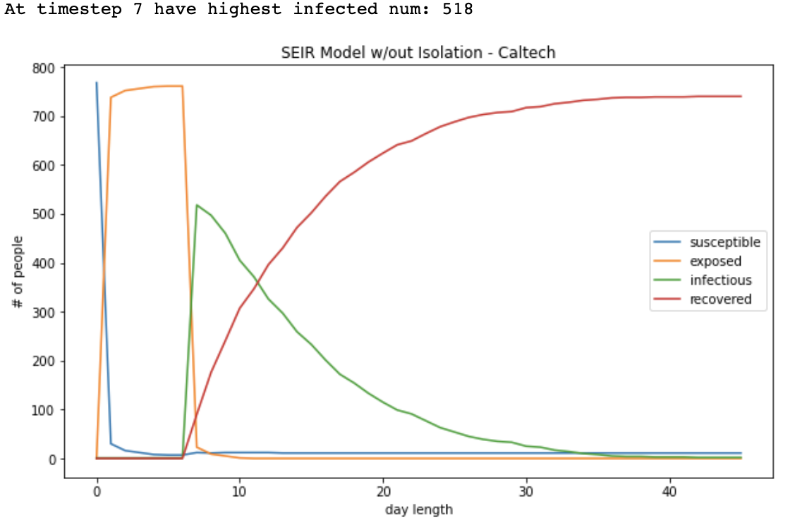
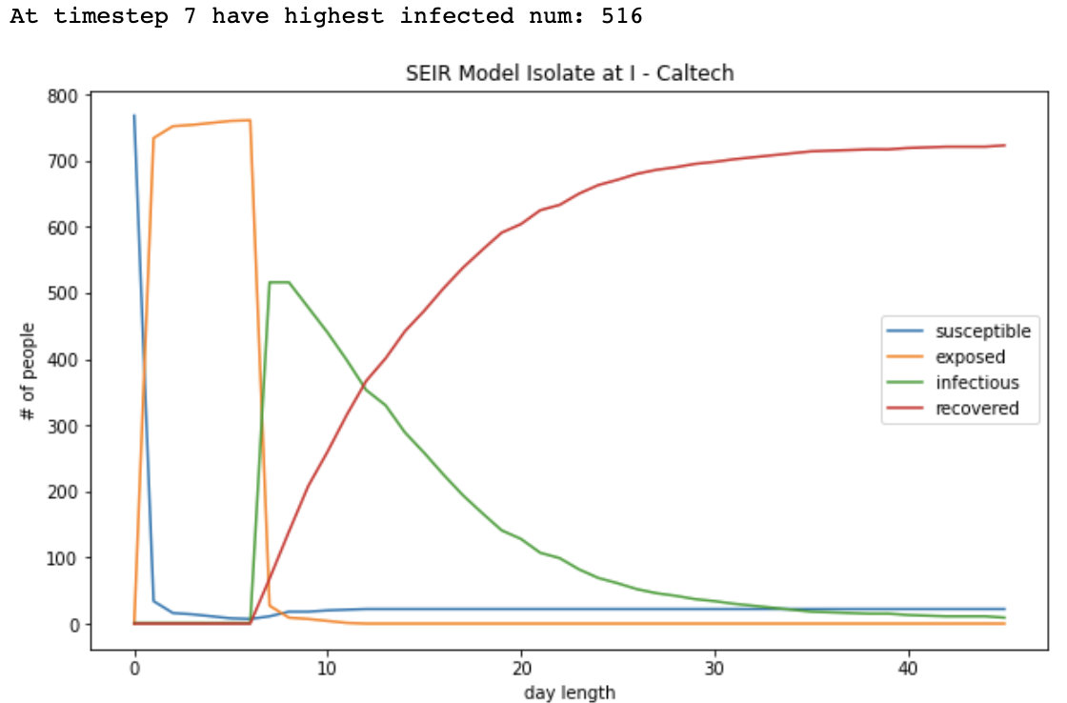
SEIR models using real network data

Slide 21
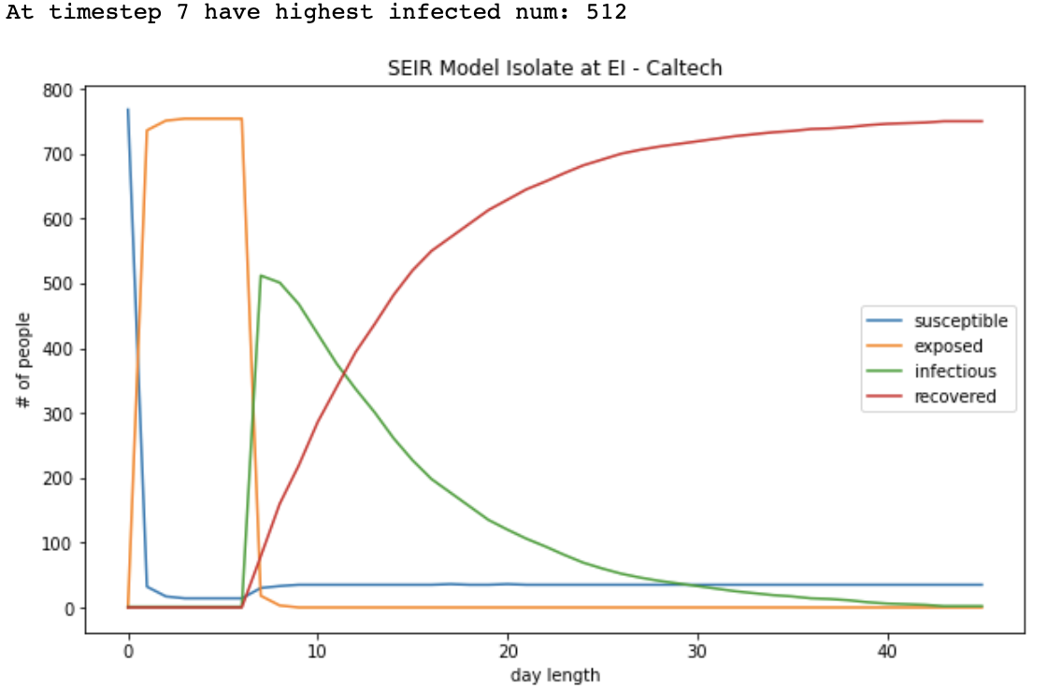

SEIR models using real network data
2 days Delay for Isolation
Immediate Isolation

Slide 22
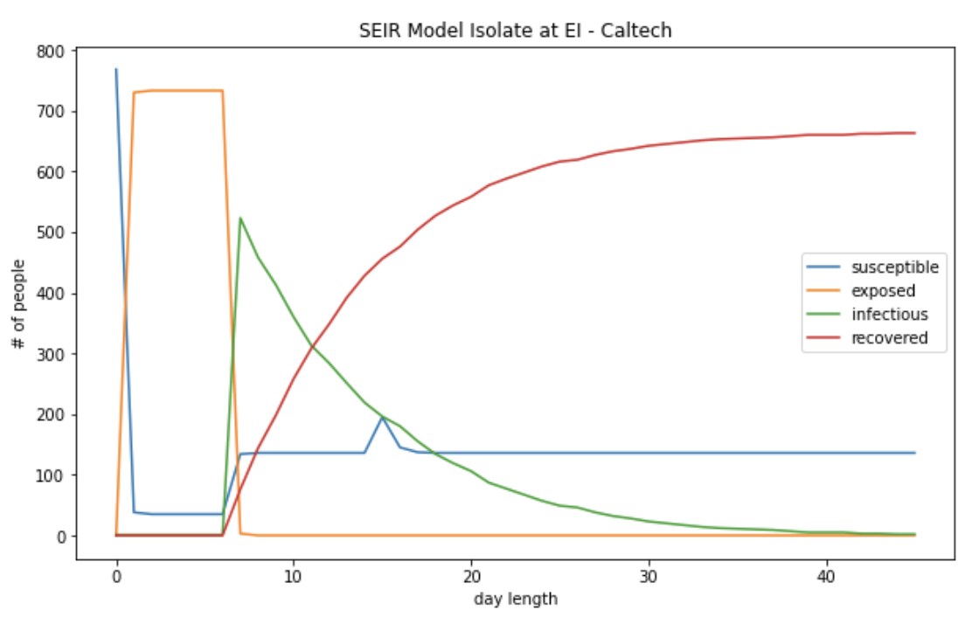
Lower p_se_isolation, higher % Isolate

Slide 23
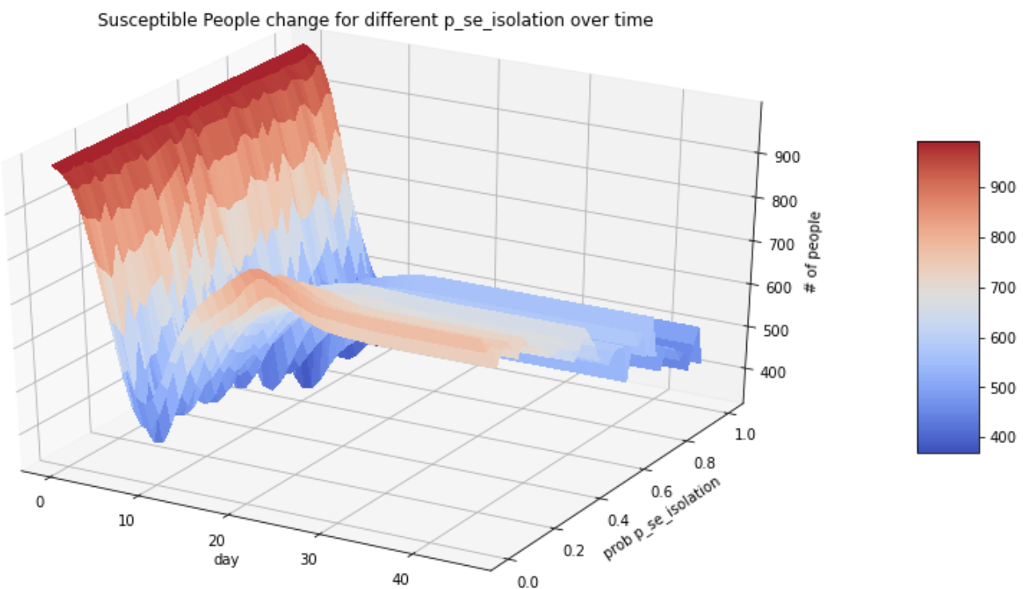
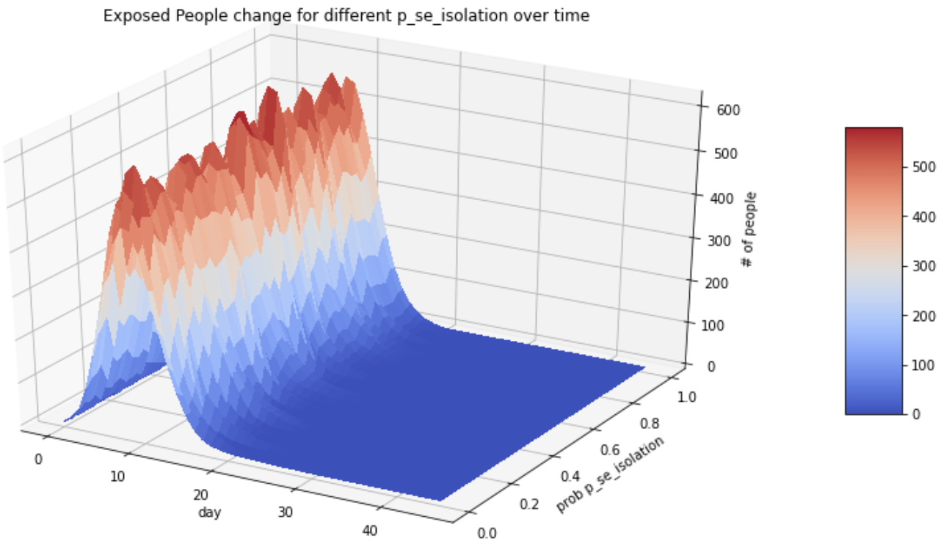
Change P_se in Isolation

Slide 24
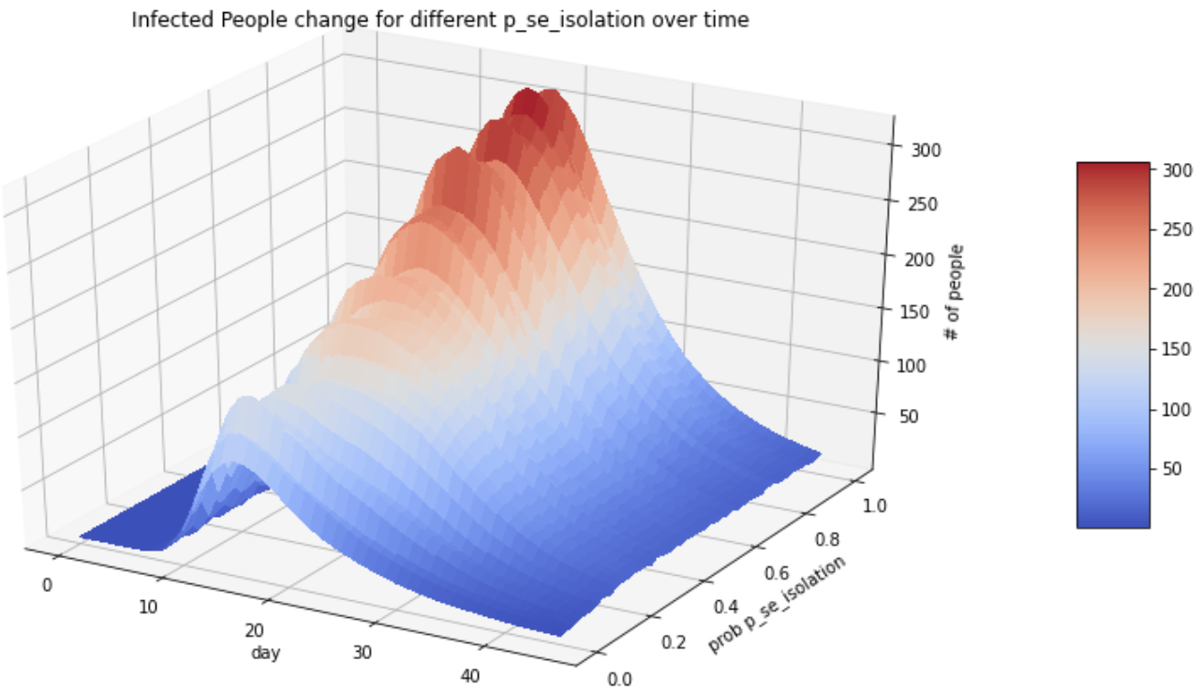
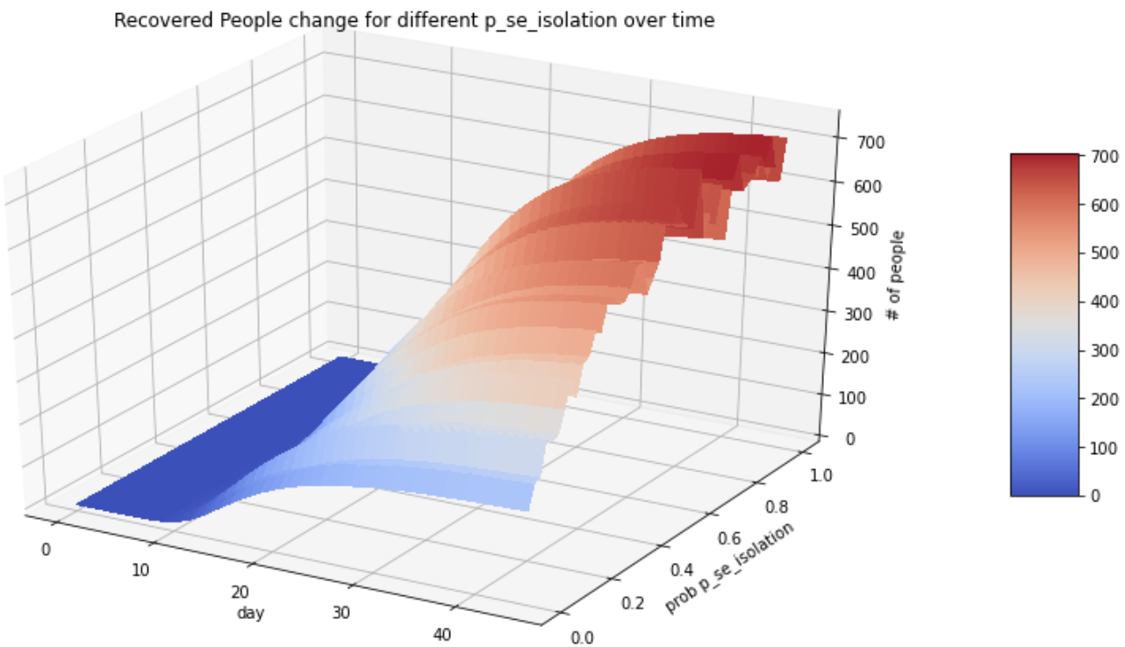
Change P_se in Isolation

Slide 25
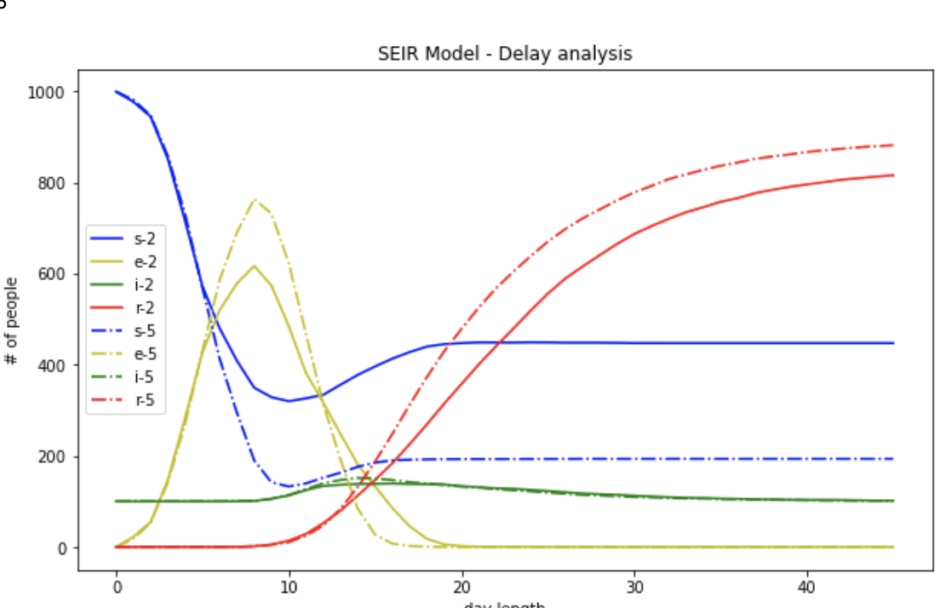
Delay Analysis

Slide 26
SEIR Conclusion
Isolation start E is important
Less delay the better
During Isolation lower the p_se

Slide 27
Future Work
Vaccination
Improving our model by adding more parameters
Introducing Asymptomatic population
Simulations for different communities types by changing infection rate

Slide 28
Thank You
Q & A

